Slide 1
Discrimination & Harassment:
Your rights and resources
Kassandra Alberico, Equal Opportunity and Title IX

Slide 2
Agenda
Before we start....
A little about Me
What is Title IX?
Discrimination, Sexual Misconduct and Retaliation
  Mandated Reporter
  Protected Classes
  Sexual Misconduct
  Retaliation
  Reporting to Regis University
  Options
Confidential Support
Scenario Training

Slide 3
Who here knows what the Equal Opportunity and Title IX office does?

Slide 4

Who is she?

Slide 5


Slide 6


Slide 7


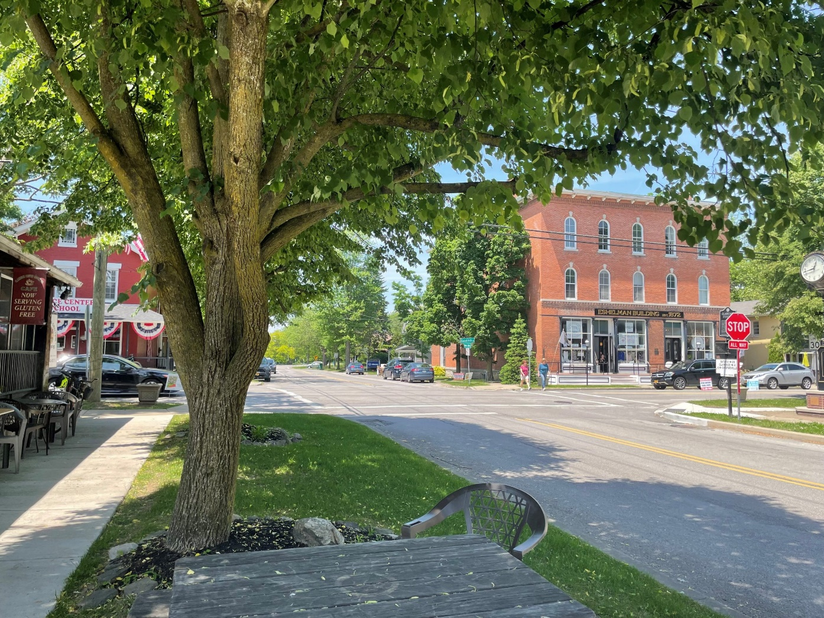

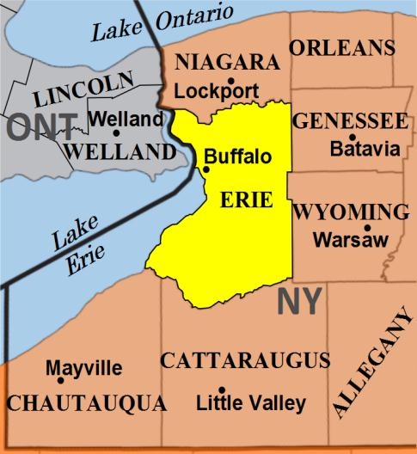
Clarence, NY

Slide 8
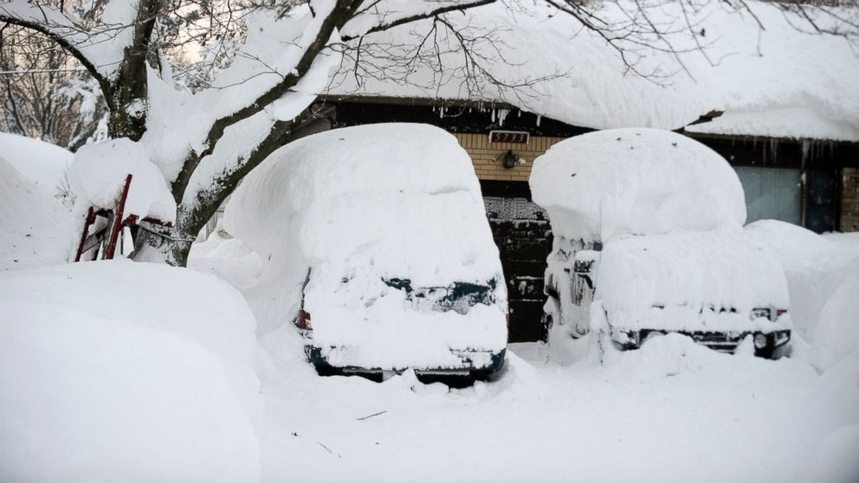


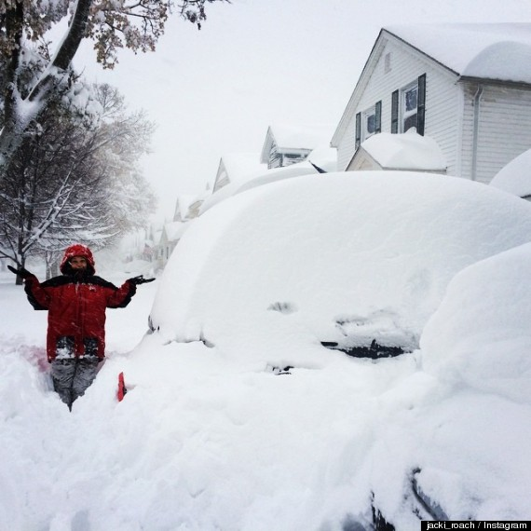
Blizzards

Slide 9

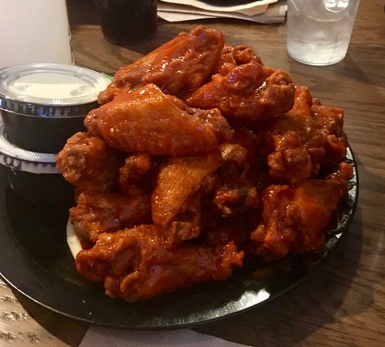



Slide 10


Slide 11


Boxing and MMA

Slide 12

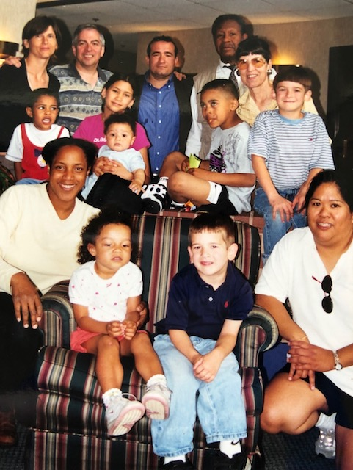
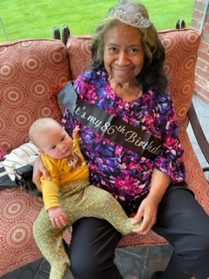
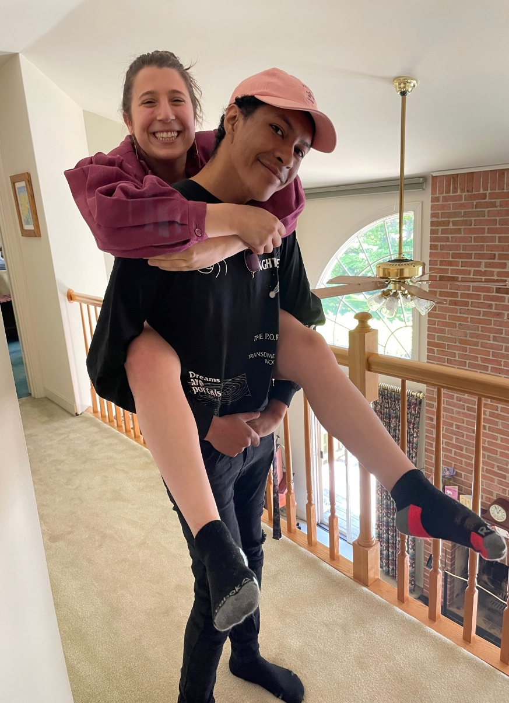
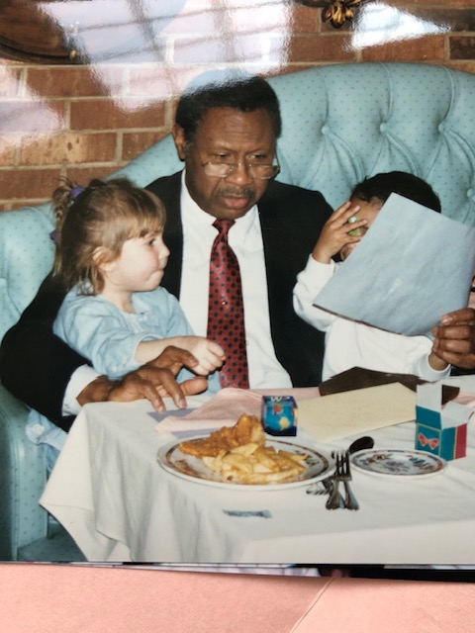
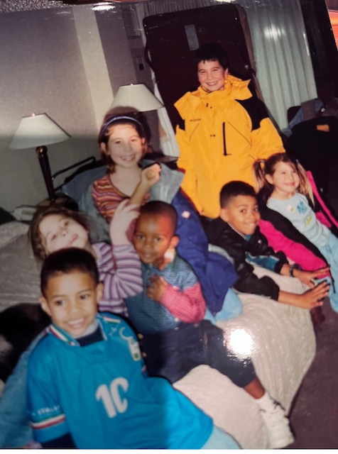
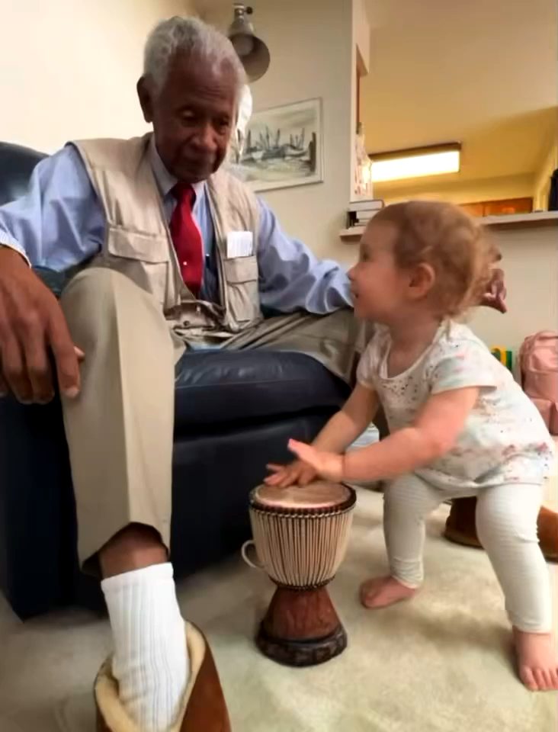
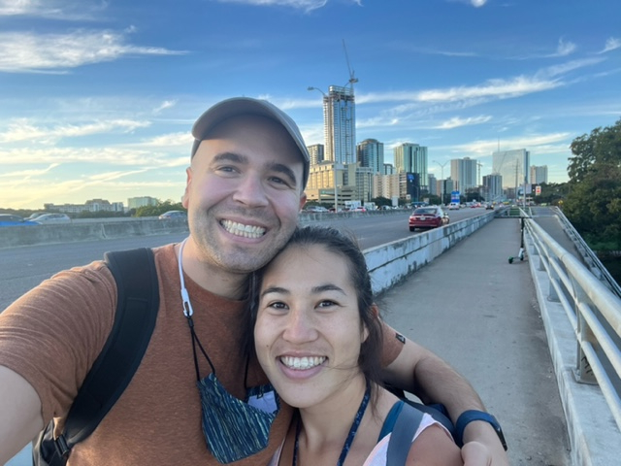


Slide 13

Colgate University
Spanish and English Literature
w/ Minor in Creative Writing
(aka an emphasis)

Slide 14


Slide 15


Slide 16



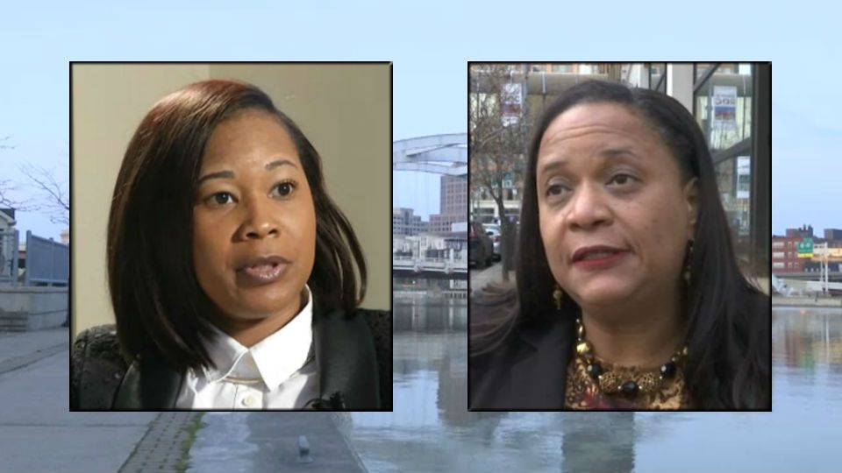
Judge Morris and Judge Bailey Turner

Slide 17

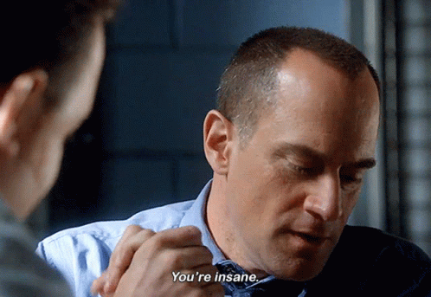


Slide 18
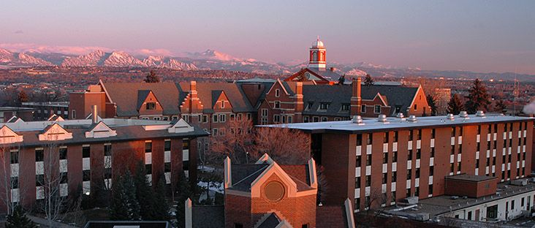

Regis University

Slide 19
Kassandra Alberico, EO & Title IX
•Not Confidential
•Not privy to information from Victim Advocate and Violence Prevention Officer, Shanese McGregor
•Coordinates policy and process for Regis community members
•Trained in Investigation, Civil Rights Law, Civil Rights-based Policies, Trauma Informed Interviewing, Due Process, and Civil Rights Coordination in Higher Education.

Slide 20
Responsibilities
Regis
When we are made aware of a report of discrimination, sexual misconduct, or retaliation, we are responsible for stopping the behavior, preventing its reoccurrence, and remedying the impact on the affected person/community
Community
All Community Members. It is the responsibility of every member of the University community to foster an environment free from Discrimination, Harassment, Sexual Misconduct, and Retaliation.
Employees. All Regis University Employees (except for Privileged and Confidential Resources) are considered Mandated Reporters and are required to promptly report any knowledge of prohibited conduct based on protected classes.
Student Employees. Student employees, including graduate assistants and teaching assistants, are required to promptly report allegations of prohibited conduct that is discovered within the course and scope of their University employment.
Students. Students are encouraged to report knowledge of prohibited conduct.

Slide 21
Mandated Reporters
Mandated Reporters means any school personnel who knows or has reason to believe a EO or Title IX violation is occurring.
Title IX uses the concept of notice, and imposes obligations for a “prompt and effective remedy” on colleges and universities when notice of sex/gender discrimination or harassment is given to a “responsible employee.” A school has notice if a responsible employee knew, or in the exercise of reasonable care should have known, about the harassment. A responsible employee includes any employee who has the authority to take action to redress the harassment, who has the duty to report sexual harassment to appropriate school officials, or an individual who a student could reasonably believe has this authority or responsibility. Your college or university will define whether you are a “responsible employee.” Some faculty members will be, and some will not.

Slide 22
Discrimination, Sexual Misconduct, & Retaliation
Regis University is committed to providing equal access to a learning and work environment free from unlawful discrimination, harassment, and retaliation.

Slide 23
Protected Classes
Regis Policy prohibits University community members from engaging in unlawful discrimination and harassment on the basis of race, color, national origin, sex (including sexual harassment, sexual violence, sexual assault, sexual exploitation, intimate partner violence, or stalking) gender, disability, age, religion, veteran status, marital status, pregnancy, parental status, gender identity, gender expression, sexual orientation, genetic information or any other legally protected status in any of its policies, programs, admissions or activities.

Slide 24
Sexual Misconduct
Sexual Misconduct is an umbrella term that includes (but is not limited to) Sexual Harassment, Nonconsensual Sexual Contact, Nonconsensual Sexual Penetration, Sexual Exploitation, Intimate Partner Violence, and Stalking, and any sexual conduct that takes place without consent of the parties involved.

Slide 25
Retaliation
Any intentional action taken by any party to a complaint or report or allied third party that harms an individual as reprisal for being party to a complaint or report under this policy or participating in a civil rights complaint proceeding.

Slide 26
Reporting to Regis
Online reporting: Equal Opportunity and Title IX Regis Webpage
Kassandra Alberico
  EO & Title IX Coordinator
  303-964-6435
  kalberico@regis.edu
  After a report, you have options.

Slide 27
Options
I will invite you to a conversation about your options, rights, and resources
My approach is to work with the impacted person(s) to build a response that they are comfortable with and that is available to them
Some possible options:
  Answer questions and concerns
  Supportive measures
  Informal resolution
  No action requested
  Transition to only confidential resources
  Formal complaint/investigation
  Referral to legal and/or criminal options (separate from the university)

Slide 28
Confidential Support

Slide 29
Confidential On Campus Resources
VAVP (Victim Advocate and Violence Prevention Officer)
Shanese McGregor
Joining us from Vanderbilt University
With more than eight years of experience in the field, her previous positions include survivor advocate at Kansas State and Ball State. She also worked as a family case manager for the Department of Child Services for the State of Indiana.
​
​

Slide 30
Confidential On Campus Resources
​
STUDENT HEALTH SERVICES​​
Serves students​​
Coors Center room 114​​
303.458.3558​
​
UNIVERSITY MINISTRY AND JESUITS​​
Serves students and employees​​
Student Center room 214​​
303.458.4153​
​
OFFICE OF COUNSELING AND PERSONAL DEVELOPMENT
Serves some students
Coors Center room 114
303.458.3507
CENTER FOR COUNSELING
& FAMILY THERAPY
Serves students and employees
500 E. 84th Ave., Thornton, CO 80229
.303.964.5786

Slide 31
Non-Confidential On Campus Resources
EQUAL OPPORTUNITY & TITLE IX
Kassandra Alberico
Serves students, employees, and visitors
Main Hall suite 133
303.964.6435
kalberico@regis.edu
HUMAN RESOURCES
Serves employees
West Hall room 107
303.458.4161
HRinfo@regis.edu
CAMPUS SAFETY
Serves students and employees
Regis Square suite 28
303.458.4122
safety@regis.edu
THE OFFICE OF THE DEAN OF STUDENTS
Serves students
Student Center room 223
303.458.4086

Slide 32
Confidential Off Campus Resources
SAFEHOUSE DENVER
www.safehouse-denver.org
24-hour domestic violence hotline:
303.328.9989
THE BLUE BENCH
www.thebluebench.org
24-hour sexual assault hotline:
303.322.7273
EMERGENCY DEPARTMENT SOCIAL WORKER
www.denverhealth.org
24-hour ER Contact:
303.602.3308
ROCKY MOUNTAIN CRISIS PARTNERS
www.metrocrisisservices.org
24-hour crisis intervention services:
1.844.493.TALK (8255)
DENVER HEALTH HOSPITAL
www.denverhealth.org
303.602.3007
To get checked out after a sexual assault, go to the emergency room entrance and ask for a SANE nurse (sexual assault nurse examiner)

Slide 33

EO and Title IX when it comes to Athletics.
How do these spheres connect?
EO & Title IX
Athletics
???
Who can give an example of a Title VII or Title IX issue that might arise within the Athletics department?

Slide 34
Scenario Training

Slide 35
A student comes to you and tells you that they think they might have been sexually assaulted. They explain that they don’t remember much from the night before but they woke up in a dorm that wasn’t there own and their clothing was disheveled. How would you respond?

Slide 36
A friend tells you that another student used a racial epithet (slur) to describe a minority group while on campus. How do you respond?

Slide 37
You see a post of a student intoxicated online and passed out in a corner. The student has derogatory speech regarding their sexual orientation written on them in sharpie. The student is believed to be gay but you don’t know whether or not it is true. How do you respond?

Slide 38

Questions?

Slide 39
Thank You!
Kassandra Alberico EO & Title IX Coordinator
303.964.6435
kalberico@regis.edu

